Slide 1
Precision Beacon Navigation
Team 1: Tahir Aziz, Casey Boyle, Adeel Khan, Alejandro Guzman, Sabur Khan
Mentor: Dr. Tom Hill, The Fellows Consulting Group
Notes:
Tahir

Slide 2
Introduction
The goal of our project was to determine if we could achieve precision beacon navigation with HP Aruba Proximity Beacons
The vision of the application is to be able to allow visually impaired people to navigate indoors
Beacons emit Bluetooth signals and are placed around the building, where their emitted RSSI values are read into the phone to determine location
Notes:
Tahir

Slide 3
Team Interaction
We defined team roles
Had 2 weekly meetings: 1 with Dr. Hill, and 1 with just the team
Slack for communication
Google Drive for file storage
Github for version control
Notes:
Tahir

Slide 4
Strategy
Understand previous work
Merge codebases
See how the app works after that
Understand bluetooth and beacons
Determine capability of current hardware
Determine effectiveness of current RSSI smoothing and trilateration code
Test application and gather data
Report on feasibility
Notes:
Tahir

Slide 5
Previous Work
2 separate apps
1 for beacon placement based on ECSS image floor map
1 for setting destination and calculating route based on ECSS image floor map
Notes:
kc

Slide 6
Constraints & Limitations
Consolidate and understand previous teams’ works on the project
Beacons emit 2 RSSI values per second and are proximity based
Couldn’t interface with beacons
RSSI bouncing
Notes:
kc

Slide 7
Added Work
Merged codebases
Image processing to detect walls on the image map
Implemented another trilateration algorithm (not used due to beacon bottleneck)
Moved config settings to a GUI from the code
Logging functionality - logs + button to record start/stop
Log to database import tool
Discovery of major bottleneck
Knowledge transfer documentation
Notes:
kc

Slide 8
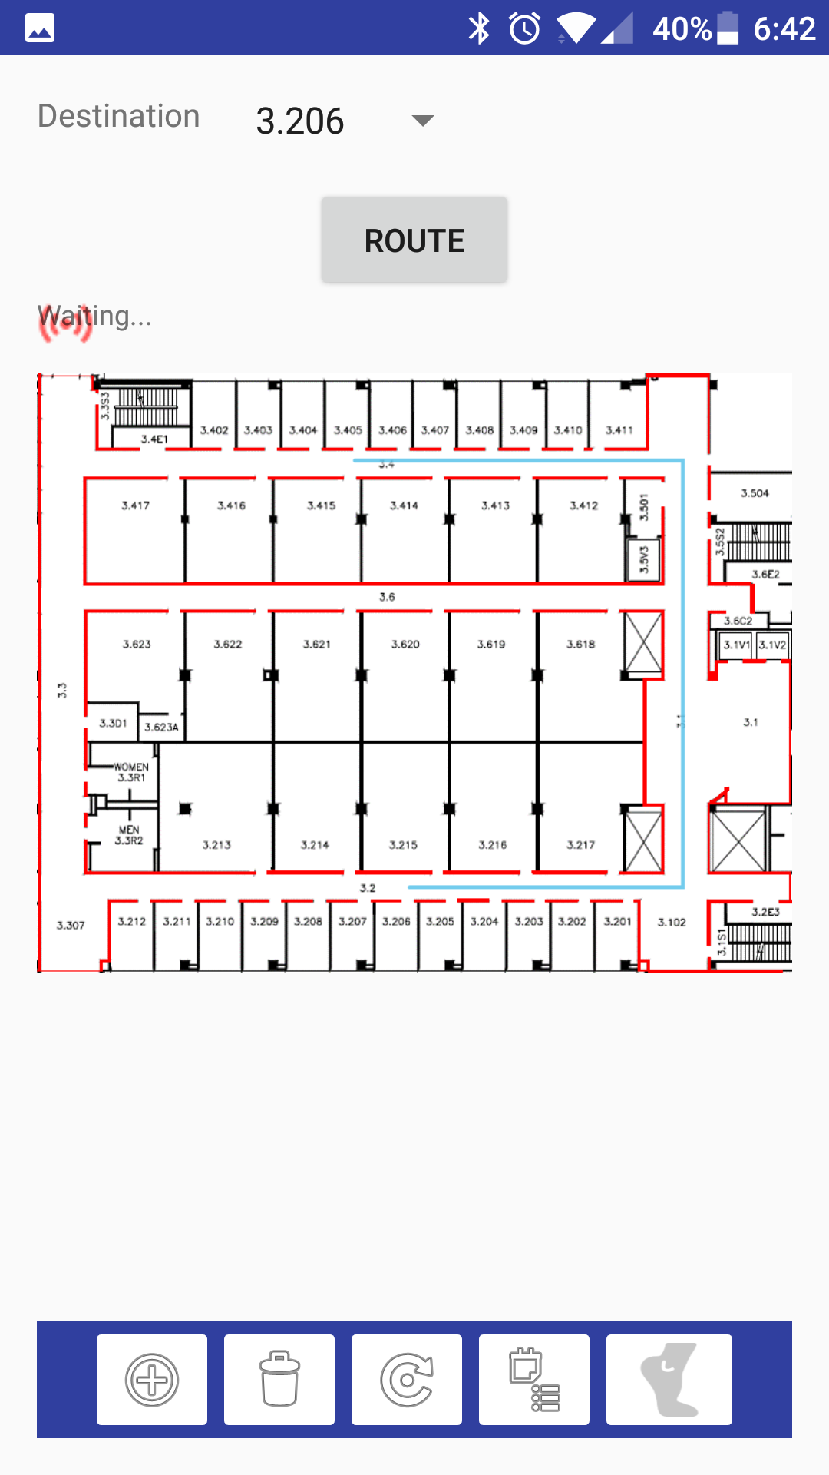
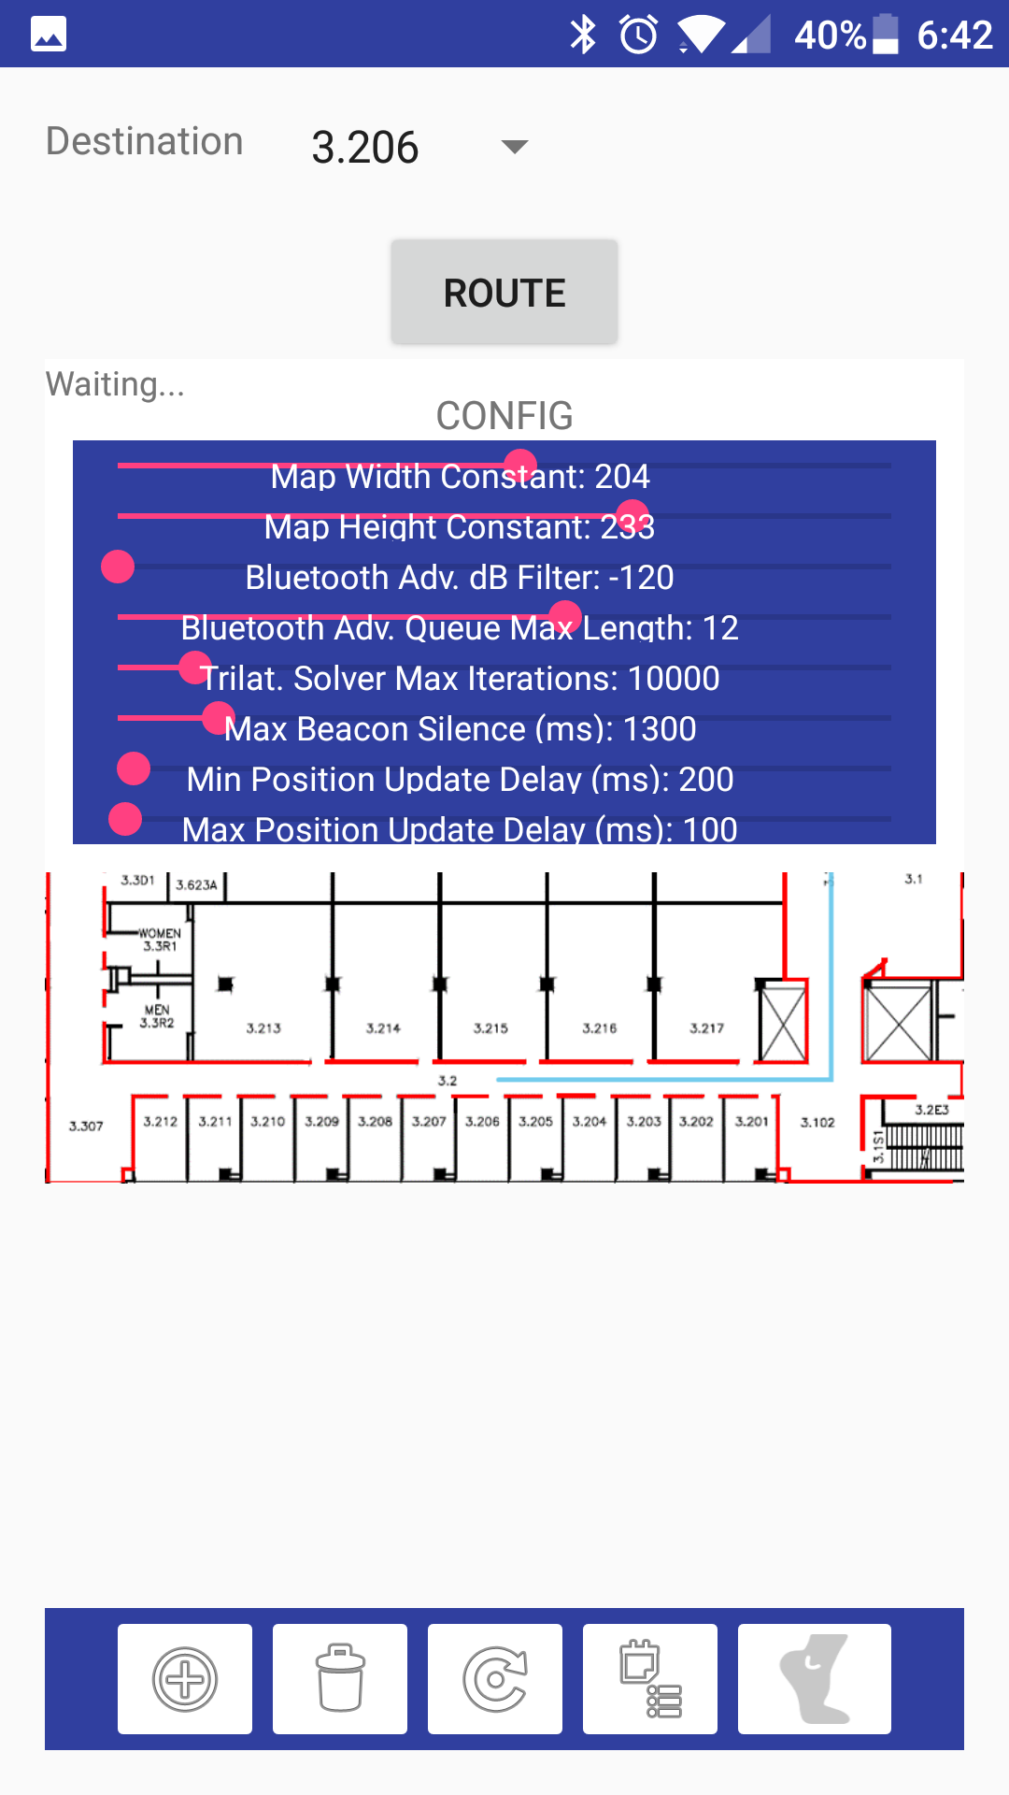
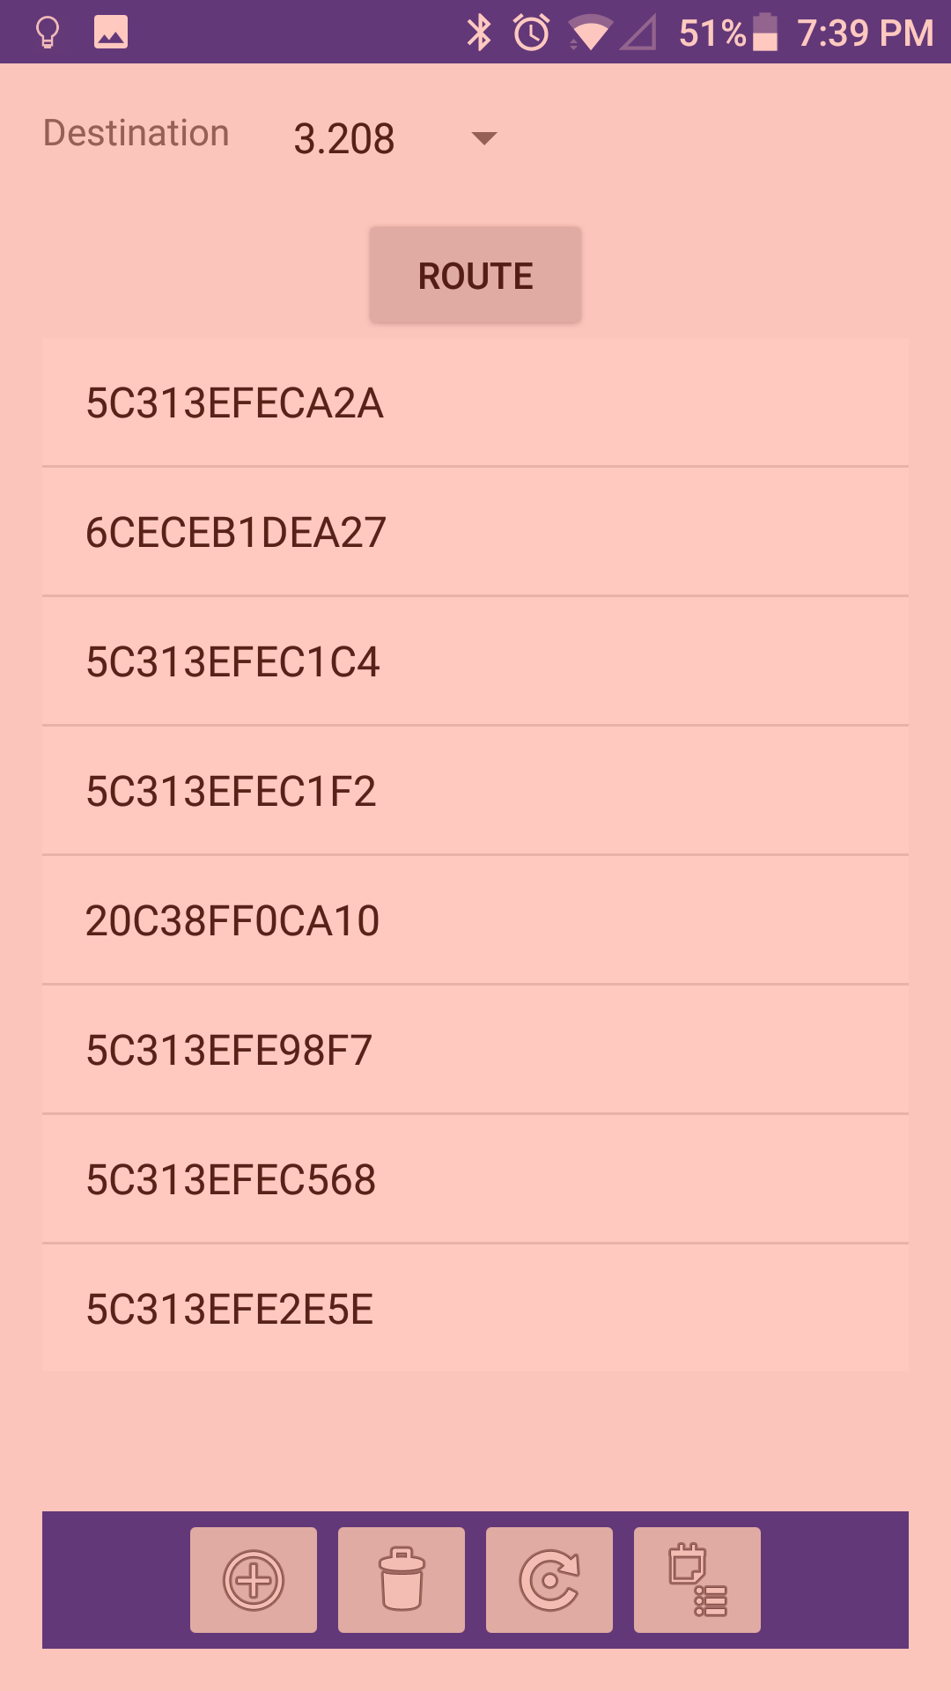
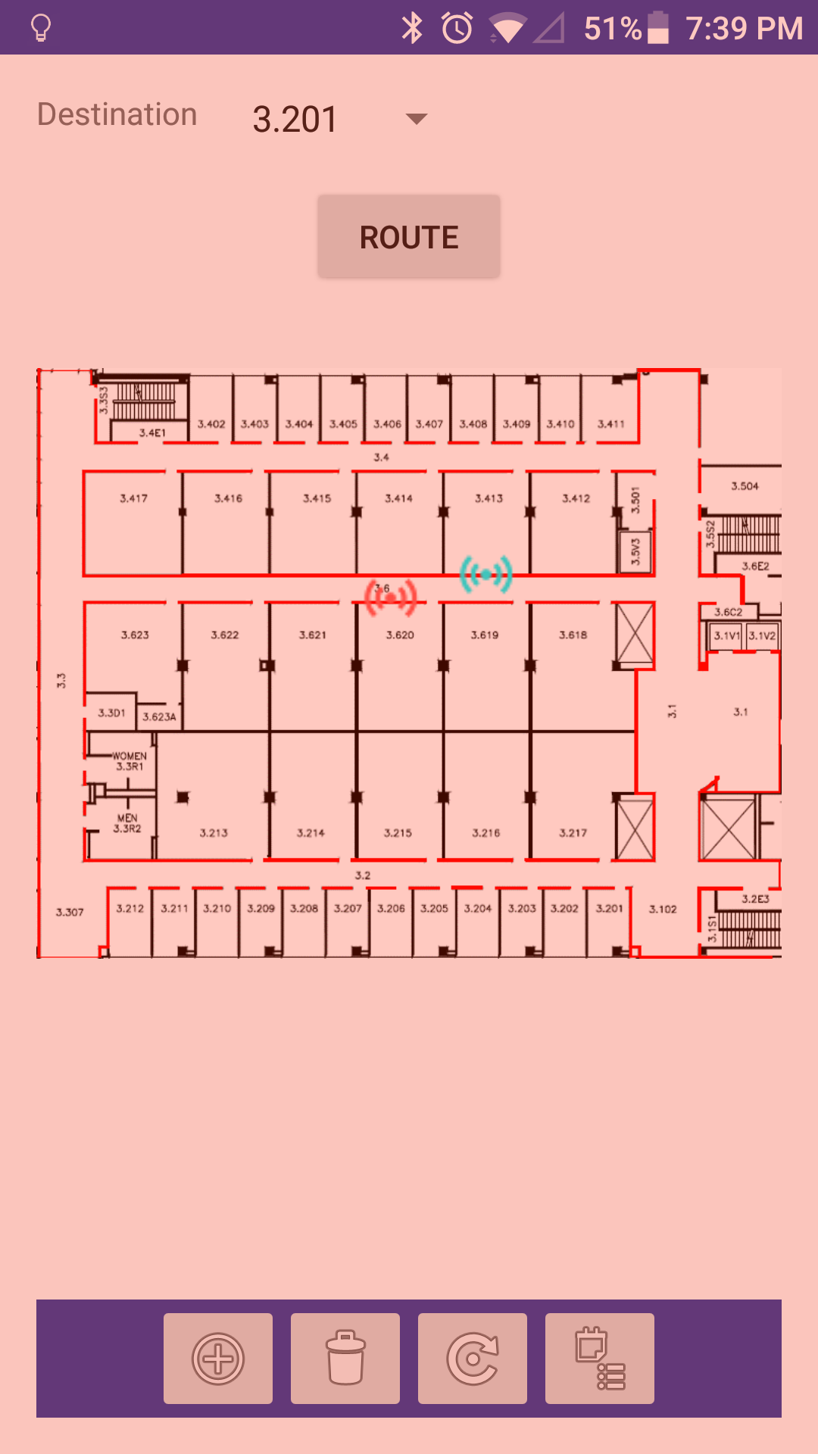
The App
Notes:
kc

Slide 9
Tests
Queue length 6, 7ft spacing, stationary
Queue length 12, 7ft spacing, stationary
Queue length 6, 7ft spacing, walking normally
Queue length 12, 7ft spacing, walking normally
Queue length 6, 14ft spacing, stationary
Queue length 12, 14ft spacing, stationary
Queue length 6, 14ft spacing, walking normally
Queue length 12, 14ft spacing, walking normally
Notes:
Alex

Slide 10
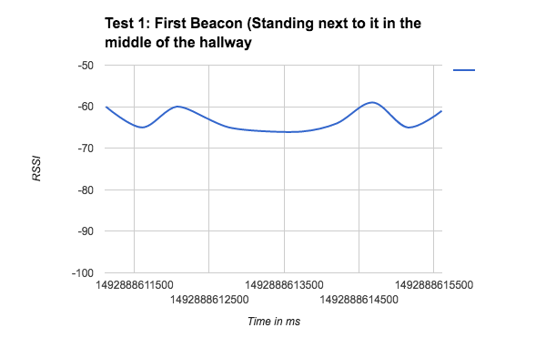
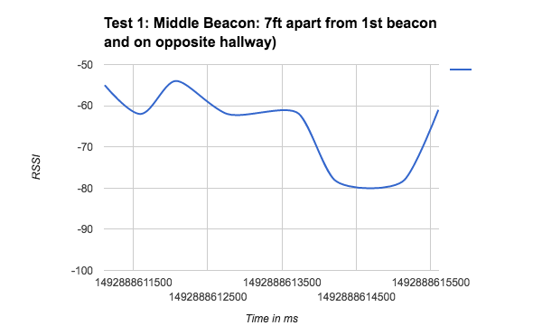
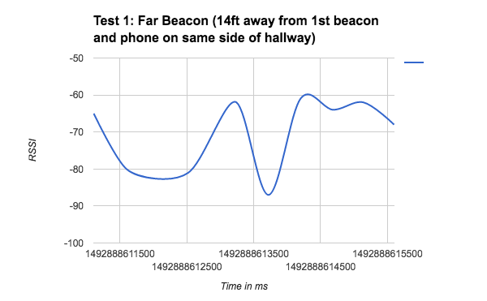
Stationary Test
Notes:
Alex

Slide 11
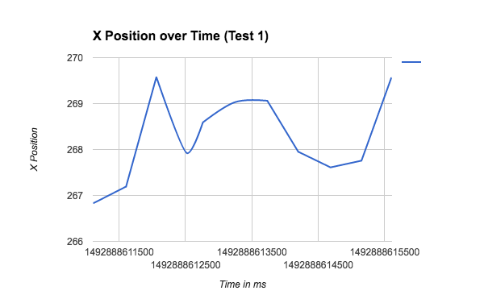
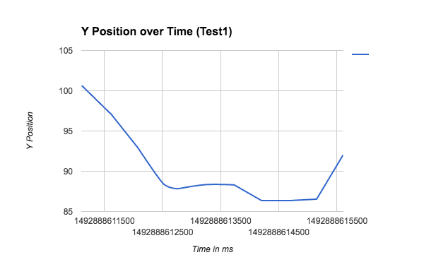
Stationary Test
Notes:
Alex

Slide 12
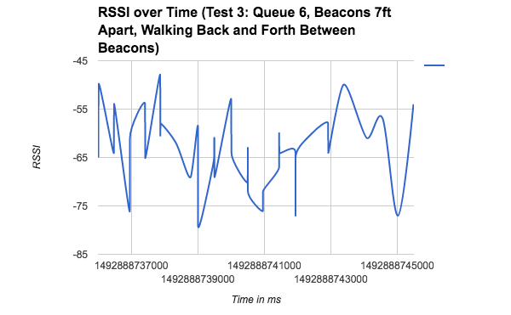
Walking Test
Notes:
Alex

Slide 13
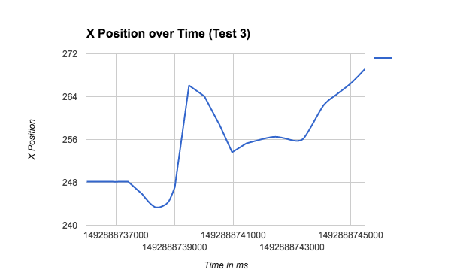
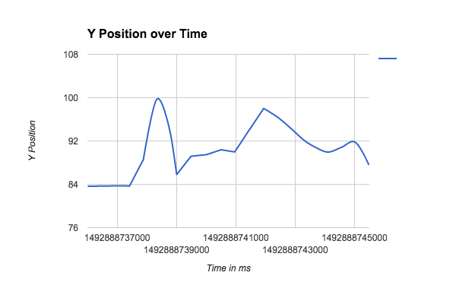
Walking Test
Notes:
Alex

Slide 14
Findings
Current hardware insufficient for precision
Emits just 2 RSSI values per second
The beacons are proximity not location based beacons
Low emission frequency major bottleneck
RSSI sent to queue, RSSI smoothing uses the queue, results passed to trilateration
Increasing the queue length leads to slightly higher accuracy but slower update time
Position estimation is inaccurate even while standing still
Accurate to within a yard or so
Inaccurate if considering precision location
Trilateration algorithm runs even if received values are the same
Notes:
Alex

Slide 15
Conclusions
There are other beacons that have SDKs and can communicate 2-way
It looks like a higher frequency of RSSI values can mitigate RSSI bouncing
Knowledge Transfer is very important
Our main discovery was that the RSSI emission frequency was a bottleneck to achieving the application’s purpose
Notes:
Adeel

Slide 16
Future Directions
Mitigate RSSI bouncing:
Get beacons that emit RSSI values at a higher frequency
Improve RSSI smoothing and Trilateration algorithms
Perform more testing and do more data analysis
Improve usability for the current application so it’s easier to work with
Implement the rest of the app
Determine business plan
Notes:
Adeel

Slide 17
Acknowledgement References
“How to Write Test Cases: Step by Step Guide with Examples,” Guru99. [Online]. Available: http://www.guru99.com/test-case.html.
“Indoor Navigation Wayfinding Mobile App,” SPREO. [Online]. Available: http://spreo.co/products/wayfinding-indoor-navigation-and-digital-displays/.
“Making indoor worlds discoverable,” IndoorAtlas. [Online]. Available: https://www.indooratlas.com/.
“SmartIndoor®,” SmartIndoor®. [Online]. Available: http://smartindoor.com/#sdk.
“Estimote,” Map any space and visualize your location within it in real-time. [Online]. Available: http://estimote.com/indoor/.
Notes:
Adeel

Slide 18
Demo
Since our application involves setting up hardware around the building and wouldn’t make sense to do in the classroom, we pre-recorded a video.
https://drive.google.com/open?id=0B9vIOB-bC_lGUXNydExEUEJlWW8
Notes:
Sabur

